Slide 1
IT 325 Web site and Web Page Design

Slide 2
Style ID selector
You can also define styles for HTML elements with the id selector. The id selector is defined as a #. Any given id name can only be referenced once within a page or document.
Example: CSS code
    p#exampleID1 { background-color: white; }
    p#exampleID2 { text-transform: uppercase; }
HTML code
<p id="ExampleID1">This paragraph has an ID name of "exampleID1" and has a white CSS defined background</p>
<p id="ExampleID2">This paragraph has an ID name of "exampleID2" and has had its text transformed to uppercase letters. </p>

Slide 3
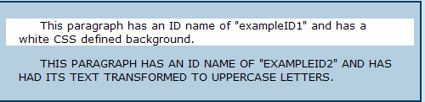
Display

Slide 4
CSS3 border-radius Property
With CSS3, you can give any element "rounded corners", by using the border-radius property.
#rcorners1 {
border-radius: 25px;
background: #73AD21;
padding: 20px;
width: 200px;
height: 150px;
}
Example: http://www.w3schools.com/css/css3_borders.asp

Slide 5
CSS3 TEXT SHADOW
h1 {
text-shadow: 2px 2px;
}
See more at:
http://www.w3schools.com/css/css3_shadows.asp

Slide 6
Responsive Web Design
Your web page should look good, and be easy to use, regardless of the device.
Responsive Web Design makes your web page look good on all devices (desktops, tablets, and phones).
One site for mobile and desktop users
Adjusts layout and content dynamically based on screen size
Can be scaled for many screen sizes or even device characteristics

Slide 7
What Does It Look Like?
An example:
http://www.w3schools.com/html/html_responsive.asp

Slide 8
How to Do it?
The easiest way: use Twitter’s Bootstrap framework
Bootstrap is a free front-end framework for faster and easier web development
Bootstrap includes HTML and CSS based design templates for typography, forms, buttons, tables, navigation, modals, image carousels and many other, as well as optional JavaScript plugins
Bootstrap also gives you the ability to easily create responsive designs
http://www.w3schools.com/bootstrap/bootstrap_get_started.asp

